Slide 1

Los Angeles County
Office of Cannabis Management
Cannabis Legal, Health, and Economic Impacts
October 24, 2018
Julia Orozco
Manager, Office of Cannabis Management

Slide 2
Decriminalization of Cannabis:
What are the penalties, what is legal now, and how do we prevent disparate enforcement?

Slide 3


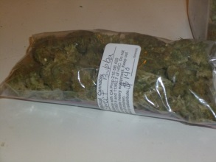
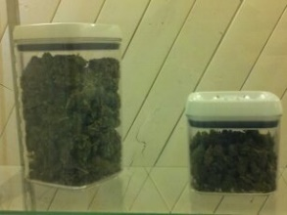
Criminal penalties reduced under Prop 64
Many activities formerly classified as felonies became misdemeanors, and some became outright legal (e.g. home grows)

Slide 4
Decriminalization
Having an arrest record often has far-reaching implications for one’s ability to obtain jobs, housing, and financial assistance.
Under Prop 64, individuals previously convicted of minor cannabis offenses can petition to have these convictions dismissed or reduced to a lesser offense (depending on what penalty would be imposed under today’s laws).
While it is estimated that about one million people in California (and potentially hundreds of thousands of County residents) may qualify for relief, to date only a small fraction of these people have taken advantage of the provisions.
February 13, 2018 – The Board directed OCM to develop a Countywide Cannabis Resentencing Plan. OCM has been working closely with justice departments to ensure qualified individuals receive the relief they are due under Prop 64.
May 22, 2018 – The Board voted to support AB 1793 (Bonta), a bill that would establish a process to automatically dismiss or reduce eligible cannabis-related convictions, rather than requiring individual petitions.

Slide 5
Disparate Enforcement
Historically, African-Americans and Latinos have been disproportionately impacted by enforcement of cannabis-related laws, despite using cannabis at roughly the same rates as other groups.
In many jurisdictions where cannabis has been legalized, communities of color continue to bear a greater burden of cannabis arrests compared to other communities, even though consumption rates are relatively equal amongst whites, blacks and Latinos.
For example, following legalization in Colorado, Washington DC and Alaska, African-Americans were still 3-10 times more likely than Caucasians to be arrested for public consumption of cannabis.
LA County wants to keep a watchful eye on this trend. The Board’s Feb. 2018 resentencing motion called for data tracking to monitor enforcement of cannabis-related laws and prevent disproportionate impacts.

Slide 6
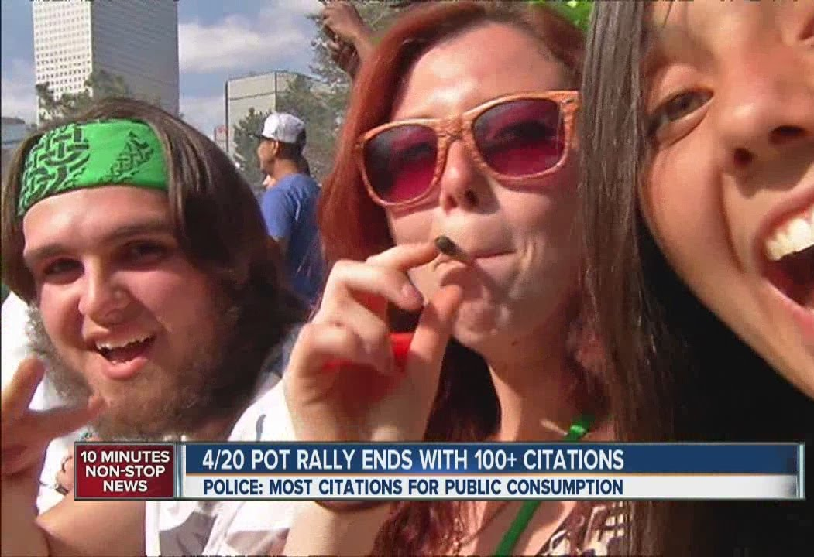
Public Consumption
It remains illegal to:
  Consume cannabis in public, or anywhere tobacco smoking is prohibited
  Smoke cannabis within 1000 feet of schools, day cares, or youth centers when children present, except in a private residence and only if smoke is not detectable on the grounds of the school, day care, or youth center
Will public consumption rules result in inequity?
What if it’s medical cannabis?

Slide 7
Rights of Non-Smokers
Landlords and property owners can prohibit cannabis consumption on private property
Tenants may have private rights of action against smoke that rises to the level of a nuisance under tort law
What if it is medical cannabis?

Slide 8
On-site consumption
MAUCRSA allows local jurisdictions to authorize on-site consumption of cannabis by state-licensed retailers and/or microbusinesses if
  (1) access to the area where cannabis consumption is allowed is restricted to persons 21 years of age and older
  (2) cannabis consumption is not visible from any public place or nonage-restricted area
  (3) the sale or consumption of alcohol or tobacco is not allowed on the premises
Onsite consumption ok at temporary events if allowed by the local jurisdiction and properly licensed

Slide 9
Public Health Considerations
What should we be watching for in the next few years?

Slide 10
Impacts to youth
Harms associated with regular or heavy cannabis use by youth:
  Reduced educational attainment and educational development
  Adverse changes in the brain impacting memory and learning
  Increased truancy and dropout rates for high-schoolers
  Tendency to engage in high-risk activities
Source: California Department of Public Health, Marijuana and Tobacco Use – Fact Sheet (May 2017)

Slide 11

Youth-targeted advertising
  “This is a time in life of great vulnerability to social influences, and the pervasive presence of tobacco product marketing—including everything from sleek ads in magazines to youth-generated posts on social networking sites, to images of smoking in the movies—conveys messages that make tobacco use attractive to youth and young adults.”
      - U.S. Surgeon General, “Preventing Tobacco Use Among Youth and Young Adults” (2012)
  Branded characters, product placement, and celebrity endorsements (particularly by athletes) can induce children to purchase certain products.

Slide 12
State law advertising restrictions
No advertising within 1,000 feet of schools, day care centers, “youth centers” and playgrounds (Bus. & Prof. Code 26152(g))
No advertising that is “attractive to children” or intended to encourage youth use (Bus. & Prof. Code 26152(e)-(f))
No billboard ads by licensees along interstate highways and state highways that cross into another state (Bus. & Prof. Code 26152(d))
Broadcast, digital, and print ads are restricted to audiences where at least 71.6 percent of audience members are reasonably expected to be 21 or older (Bus. & Prof. Code 26151(b))

Slide 13
Secondhand Smoke
“Exposure to smoke from marijuana is harmful to health just as exposure to tobacco smoke is. If the state of California takes the step of legalizing recreational marijuana, the state’s laws related to smoke-free indoor spaces, public smoking, and public consumption and intoxication from alcohol could be reviewed as possible guidelines in relation to public smoking or consumption of marijuana.”
--Pathways Report; Policy Options for Regulating Marijuana in California, California Blue Ribbon Commission on Marijuana Policy

Slide 14
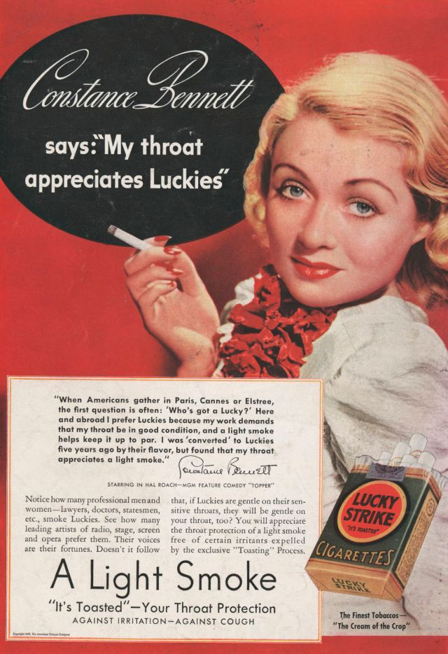

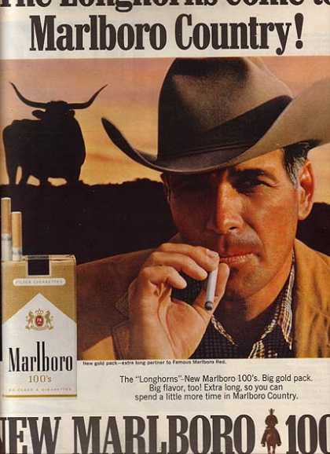

Contemporary cannabis marketing

Slide 15



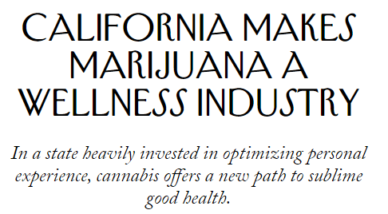
Health-related claims for adult-use cannabis

Slide 16
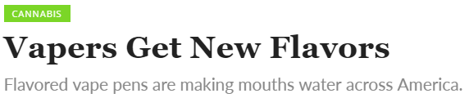
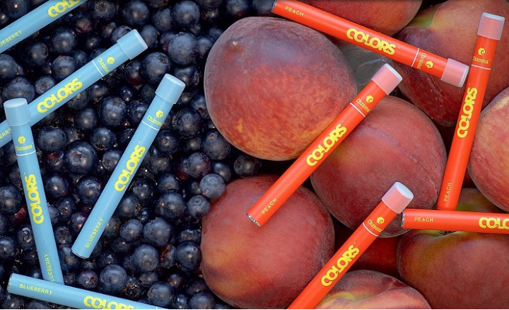
Health-related claims?

Slide 17
Economic Considerations
The Green Rush?

Slide 18

California Cannabis Industry
Sales could hit $3.7 billion by the end of 2018 and $5.1 billion by 2019
Legal cannabis industry could reach $25 billion by 2026
99,000 direct and 47,000 indirect cannabis jobs in the state by 2021
BDS Analytics & Arcview Market Research: US Legal Cannabis: $40 Billion Economic Output report

Slide 19
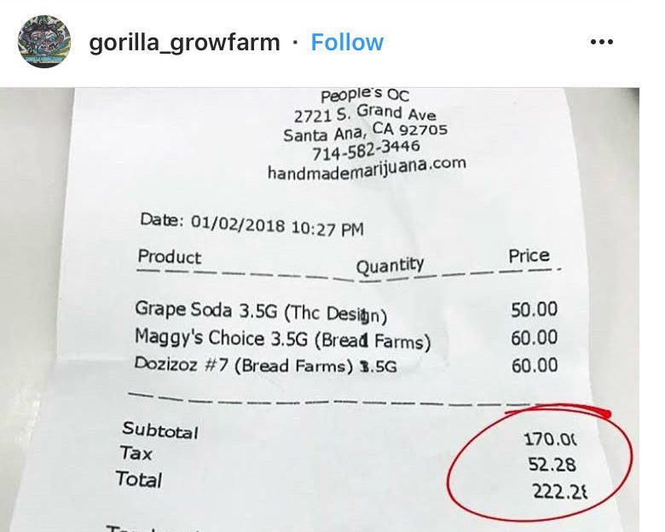
Fool’s Gold?
Slow rate of licensing
  Estimated by Weed Maps that 85%-90% of the industry that existed in 2017 is not licensed today
  85% of local jurisdictions in the state have bans on recreational marijuana retailers
Taxes
  Can be up to 80% effective tax rate
Difficulty in Enforcement
  Due Process
  Cost to jurisdictions
https://www.newsweek.com/california-cannabis-sells-35-million-under-projections-1078906

Slide 20
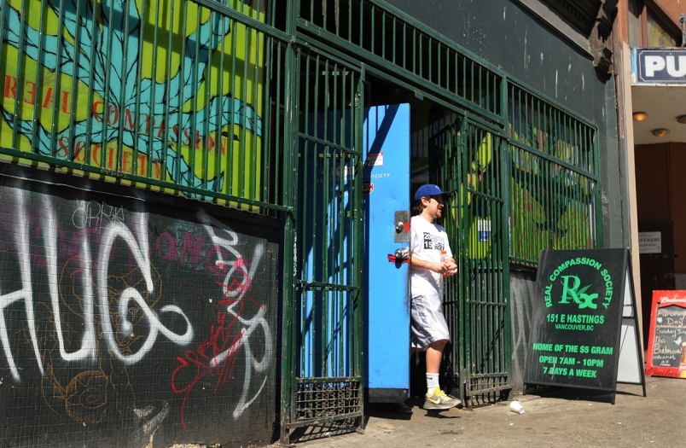
The Illicit Market
The biggest competitor to legal cannabis.
Illegal businesses avoid:
Taxation: 15% excise tax + local taxes
  Licensees pass on these costs to consumers
Compliance costs: testing, packaging, zoning, and other regulations

